Slide 1
Technical Slide Deck

Slide 2
Presentation Overview
Design Objectives / Technical Roadmap & Vision
OCORA Scope
CCS On-Board Logical Architecture
CCS On-Board Physical Architecture
Building Blocks
Train Integration Scenarios
Network Topology Scenarios
Computing Platform
Functional Vehicle Adapter (FVA)
Modular Safety
Methodology & Tooling
Operational Concept

Slide 3
Design Objectives Technical Roadmap & Vision

Slide 4

OCORA Design Objectives
A reasonable number of Building Blocks are defined for CCS On-Board.
Each Building Blocks has standardised functionality, standardised interfaces, standardised performance (RAM), standardised safety (including Tolerable Functional Failure Rate [TFFR], Safety Integrity Level [SIL] and Safety Related Application Conditions [SRAC]), and standardised security.
Modular
RAMSS
Exchangeable
Migratable
Portable
Evolvable
Secure
Ability to protect the CCS On-Board from attacks. In context of OCORA security means the protection of (especially safety related communication and data used in) CCS on-board systems against threats (in particular cyber-attacks and hacks). To achieve this, all main security functionality like identify, protect, detect, respond and recover are considered.
Ability to replace CCS On-Board Building Block. In the context of OCORA exchangeability means the ability to replace one or multiple OCORA defined building blocks with (a) respective building block(s) of (an)other supplier(s), without affecting other building blocks of the train or the overall CCS on-board system.
Ability to easily adapt the CCS On-Board to new technologies and to easily add new Building Blocks. In the context of OCORA evolvability means the ability to easily adopt to new technologies or to extend the functionality of an on-board CCS system without the involvement of the original supplier.
Ability to introduce changes to any CCS On-Board Building Block. In the context of OCORA migrateability is the ability to introduce changes to one or multiple OCORA defined building blocks, without affecting other building blocks or the overall CCS on-board system.
Ability to port CCS On-Board Software Building Blocks (software applications) from one computing platform to another. In the context of OCORA portability is achieved when a functional application, based on the generalized abstraction, runs un-changed on different (computing) platform implementations. For this, the functional application shall only use external functions through a defined application programming interface (API).

Slide 5












Technical Roadmap – Current Situation
GSM-R
GNSS
MCG
Public Mobile Radio for
Passenger WiFi Service
CCS On-Board System
Train Adapter
Vehicle Environment
CCS On-Board Constituent
CCS On-Board Constituent
TCMS Subsystem
TCMS Subsystem
Operator Subsystem
IMU
CCS On-Board Building Block
CCS On-Board Constituent
TCMS Subsystem
Vehicle Network
TCMS Subsystem
Operator Subsystem
Radar
Odometry
EURO Balise Reader
EURO Loop Reader
IMU
Odometry
Step 0: Current Situation
Today, the proprietary CCS On-Board System is fully integrated in the proprietary Vehicle Environment, driving costs, risks, and complicating the life-cycle and obsolescence management for the railway undertakings. This current situation hinders the railways to take advantage of innovations in a timely and cost-effective manner.

Slide 6
Technical Roadmap Step 1 – Short-Term
GSM-R
GNSS
MCG
Public Mobile Radio for
Passenger WiFi Service
CCS On-Board System
Train Adapter
Vehicle Environment
CCS On-Board Constituent
CCS On-Board Constituent
TCMS Subsystem
TCMS Subsystem
Operator Subsystem
IMU
CCS On-Board Building Block
CCS On-Board Constituent
TCMS Subsystem
Vehicle Network
TCMS Subsystem
Operator Subsystem
Radar
Odometry
EURO Balise Reader
EURO Loop Reader
IMU
Odometry
Step 1: Short-Term (TSI-2022)
The interface between the proprietary CCS On-Board System and the Vehicle Environment is unambiguously standardised.
Step 1 is enabling exchangeability, is supporting migrateability and portability of the CCS On-Board System without affecting the Vehicle Environment.
Step 1 is simplifying life-cycle and obsolescence management for the CCS On-Board System.

Slide 7







Technical Roadmap Step 2 – Mid-Term
CCS Off-Board Support
Remote Maintenance
Asset Management
Remote Supervision
Remote Driving
GNSS
GSM-R
FRMCS
MCG
Public Mobile Radio for
Passenger WiFi Service
CCS On-Board System
Connectivity
Services
Train Adapter
Vehicle Environment
Perception
CCS On-Board Building Block
CCS On-Board Building Block
CCS On-Board Building Block
TCMS Subsystem
TCMS Subsystem
Operator Subsystem
Com Net
IMU
CCN
CCN
Sec Net
TCMS Subsystem
Vehicle Network
CCS On-Board Building Block
CCS On-Board Building Block
CCS On-Board Building Block
TCMS Subsystem
Operator Subsystem
Cyber Security
Services
Radar
Odometry
EURO Balise Reader
EURO Loop Reader
Odometry
Step 2: Mid-Term (TSI-2025)
The CCS On-Board System consists of a well balanced number of CCS On-Board Building Blocks. Each Building Blocks has standardised functionality, standardised performance (RAM), standardised safety (including Tolerable Functional Failure Rate [TFFR], Safety Integrity Level [SIL] and Safety Related Application Conditions [SRAC]), standardised security, and standardised interfaces towards other building blocks and/or external systems, allowing to mix-and-match Building Blocks from different suppliers.
The CCS On-Board Building Blocks communicate with each other, with the Vehicle Subsystems and any Off-Board System via the standardized CCS Communication Network (CCN) and the Connectivity Services, using FRMCS or the MCG. Cyber Security Services provide Identity and Access Management (IAM), security patch updates, synchronized time services, and other means to allow secure operations.
Step 2 is enabling exchangeability, is supporting migrateability and portability of the individual CCS On-Board Building Blocks without affecting other CCS On-Board Building Blocks, the Vehicle Environment, and any Off-Board Systems. This step is simplifying life-cycle management and is the basis for the railways to consider adding new functionality such as:
Step 2 is enabling the sharing of the following peripheral devices between CCS On-Board and the Vehicle Environment:
Remote Maintenance
Asset Management
Absolut continues safe localisation (GNSS)
Safe Train Integrity determination
Safe Train Length determination
ETCS L3
ATO GoA 1-4
Remote Supervision
Remote Driving
Mobile Communication Gateway (MCG)
GNSS antenna and receiver
Inertial Measurement Unit (IMU)

Slide 8
Technical Roadmap Step 3 – Long-Term
CCS Off-Board Support
Remote Maintenance
Asset Management
Remote Supervision
Remote Driving
GNSS
FRMCS
MCG
Public Mobile Radio for
Passenger WiFi Service
CCS On-Board System
Connectivity
Services
Train Adapter
Vehicle Environment
Perception
CCS On-Board Building Block
Application 2
Application 1
TCMS Subsystem
TCMS Subsystem
Operator Subsystem
Safe Computing Platform
Com Net
IMU
CCN
CCN
Sec Net
TCMS Subsystem
Vehicle Network
CCS On-Board Building Block
TCMS Subsystem
Operator Subsystem
Application 3
Application 4
Cyber Security
Services
Radar
Odometry
EURO Balise Reader (Option)
EURO Loop Reader (Option)
Odometry
Step 3: Long-Term (TSI-2028)
The CCS On-Board System includes a safe computing platform, hosting CCS Building Blocks as applications that communicate with each other, with the Vehicle Subsystems and any Off-Board System via a standardized API, the standardized CCS Communication Network (CCN) and the Connectivity Services, using FRMCS or Public Mobile Radio.
Due to the increased performance of the CCS On-Board localisation, EURO Balise and EURO Loop readers may not be needed anymore for trains running on certain tracks.
Step 3 is simplifying the portability of the business logic.
Step 3 is simplifying the development and deployment of new functionalities by separating the business logic from the hardware. In addition, the Safe Computing Platform is reducing the number of CCS computing units (CCUs) needed, increasing availability and reducing maintenance efforts.

Slide 9
Technical Roadmap Step 4 – Vision
CCS Off-Board Support
Remote Maintenance
Asset Management
Remote Supervision
Remote Driving
GNSS
FRMCS
MCG
Public Mobile Radio for
Passenger WiFi Service
CCS On-Board System
Connectivity
Services
Vehicle Environment
Perception
CCS On-Board Building Block
Application 2
Application 1
TCMS Subsystem
TCMS Subsystem
Operator Subsystem
Safe Computing Platform
Com Net
IMU
CCN
CCN
Sec Net
TCMS Subsystem
Vehicle Network
CCS On-Board Building Block
TCMS Subsystem
Operator Subsystem
Application 3
Application 4
Cyber Security
Services
Radar
Odometry
Odometry
Step 4: Vision ( > TSI 2028)
The standardised CCS On-Board Communication Network (CCN) is fully integrated with the Vehicle Network, allowing to interface from any CCS On-Board Application directly with any Vehicle Subsystems and vice-versa. The need for a Train Adapter vanishes and certain Applications from the Vehicle Environment may be hosted on the CCS On-Board Safe Computing Platform.
Due to the increased performance of the CCS On-Board localisation through better sensor fusion algorithms, the use of GNSS localisation, digital map data, and augmentation data, the EURO Balise and EURO Loop readers are not needed anymore.
Step 4: integrating the CCS On-Board domain with the Vehicle Environment allows to reuse peripherals and applications throughout the whole train, reducing the level of hardware systems and applications needed on a train. This again will increase availability and will reduce maintenance
Step 4: eliminating the EURO Balise and EURO Loop readers further reduces the maintenance efforts and enables the infrastructure managers to implement changes more quickly.

Slide 10
OCORA Scope

Slide 11
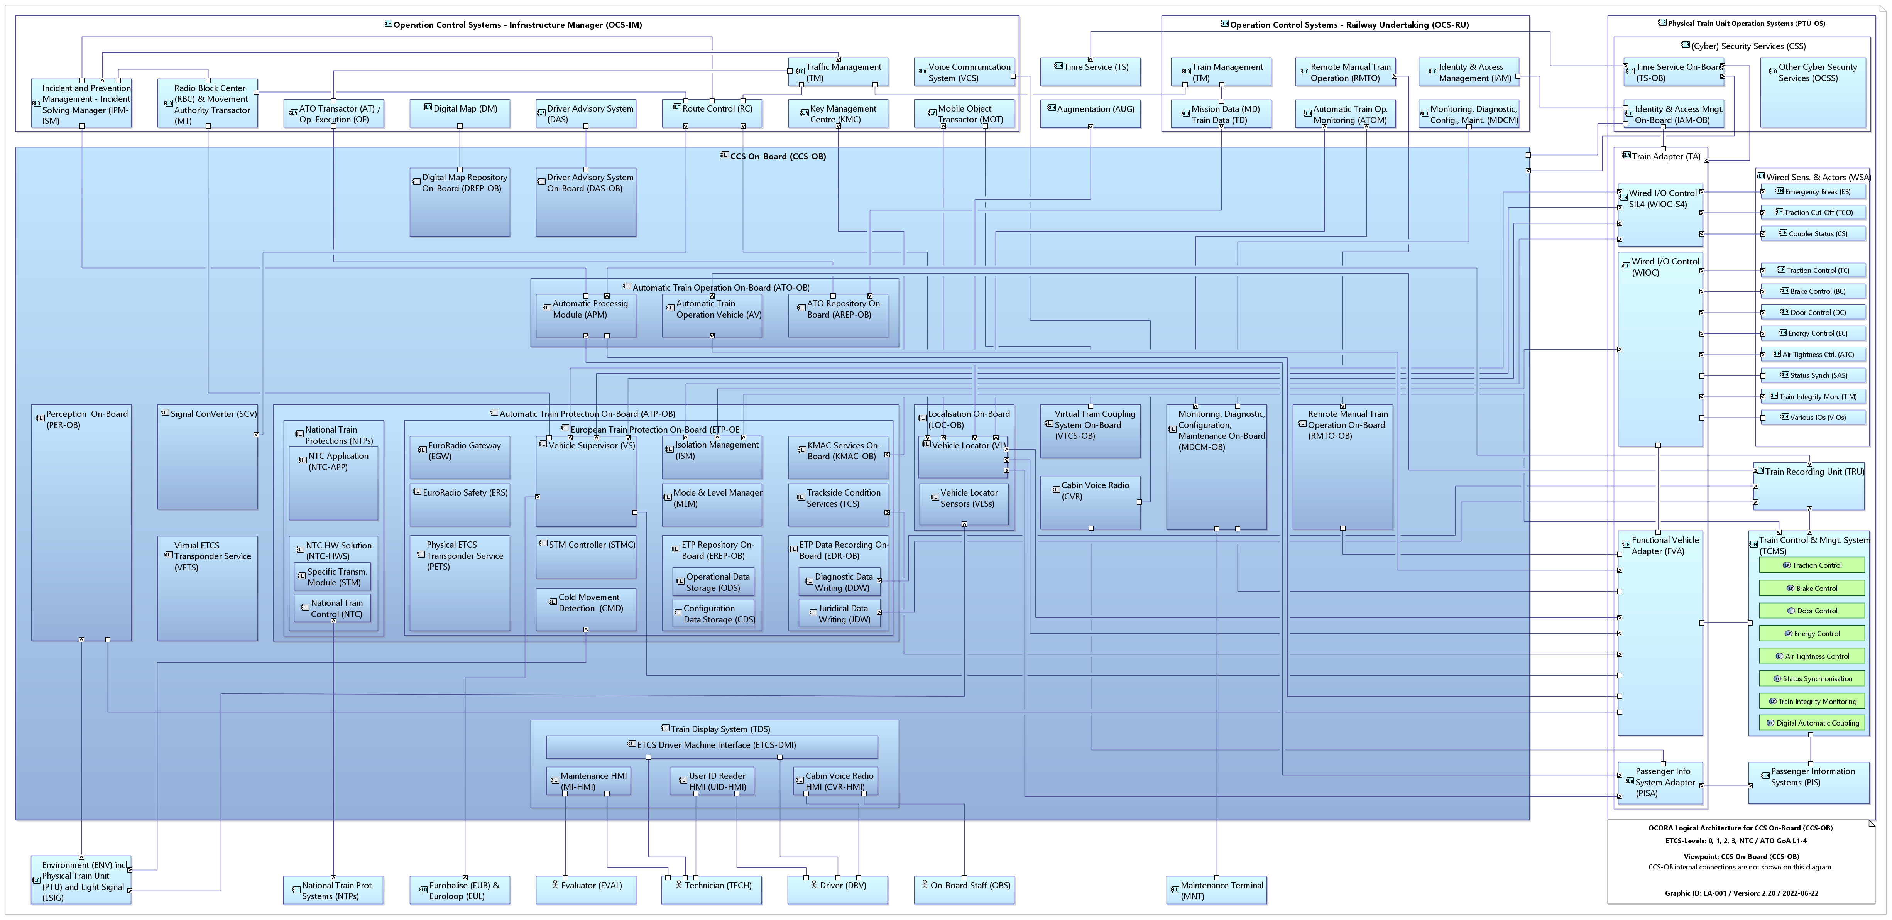
OCORA Scope – Logical Architecture
CCS Off-Board Support (COBS)
(Cyber)-Security (CSEC)
CCS On-Board (CCS-OB)
Train Adapter (TA)
1)
May be moved into the PTU-OS / LOC&PAS domain.
SS-nnn Respective subset contains information for the interface
SS-nnn* Respective subset does not address the interface but should contain the information in the future.

Slide 12
OCORA Scope – Physical Architecture (Legacy Train)
CCS Off-Board Support (COBS)
CCS On-Board (CCS-OB)
Train Adapter (TA)
(Cyber)-Security (CSEC)
Connectivity Services

Slide 13
OCORA Scope – Physical Architecture (New Generation Trains)
CCS Off-Board Support (COBS)
CCS On-Board (CCS-OB)
(Cyber)-Security (CSEC)
Connectivity Services

Slide 14
CCS On-Board (CCS-OB) Logical Architecture

Slide 15
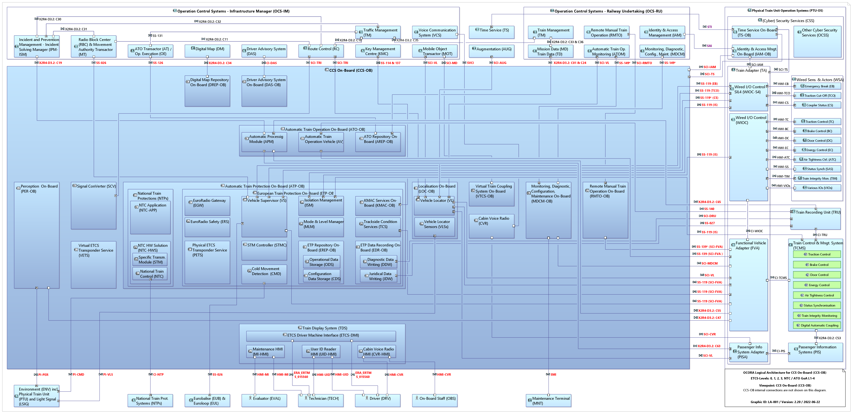
Logical Architecture CCS-OB Actors, External Interfaces, Functional Components
CCS On-Board (CCS-OB)
1)
1) May be moved into the PTU-OS / LOC&PAS domain.
May be moved into the PTU-OS / LOC&PAS domain.
SS-nnn Respective subset contains information for the interface
SS-nnn* Respective subset does not address the interface but should contain the information in the future.

Slide 16
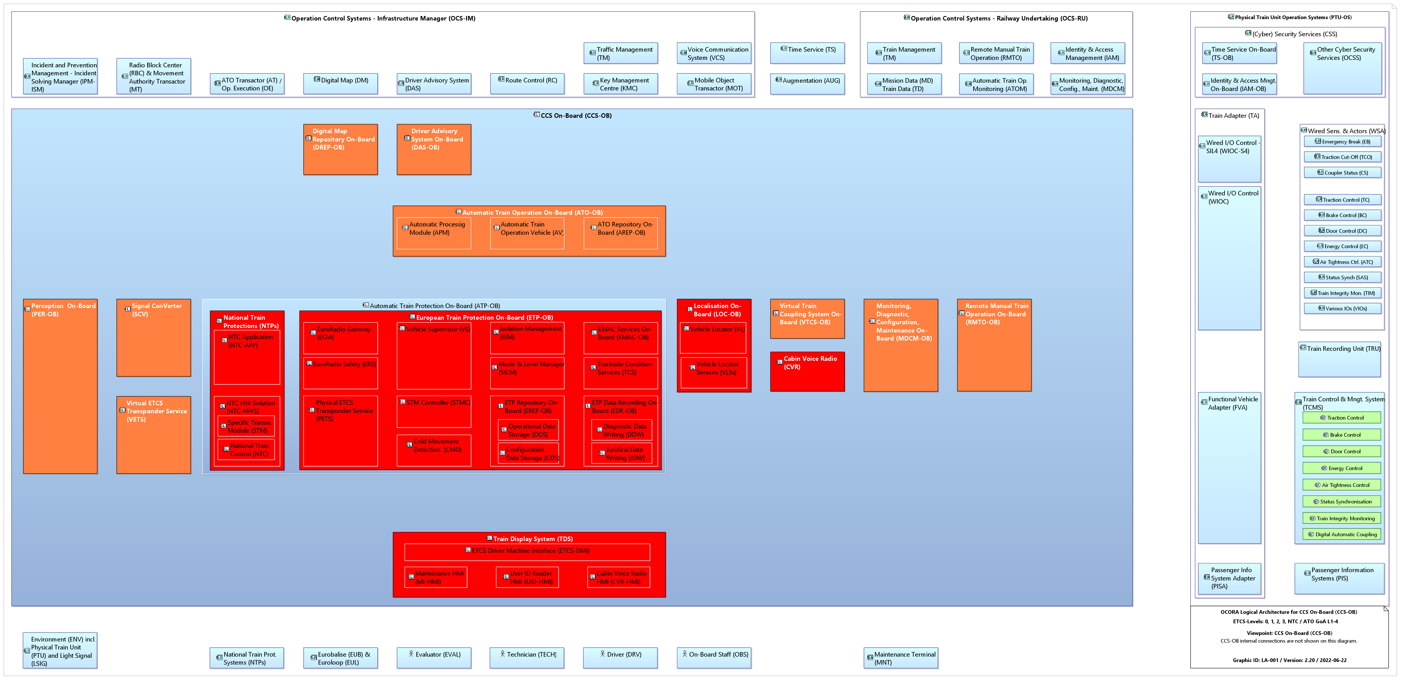
Logical Architecture CCS-OB Functional Clustering for Building Block Assignment
CCS Off-Board Support (COBS)
(Cyber)-Security (CSEC)
CCS On-Board (CCS-OB)
Train Adapter (TA)
Digital Map Repository
On-Board
(DREP-OB)
Driver Advisory System
On-Board
(DAS-OB)
Automatic Train Operation
On-Board
(ATO-OB)
Perception
On-Board
(PER-OB)
Signal Converter
(SCV)
National Train Protections
(NTPs)
European Train Protection On-Board
(ETP-OB)
Localisation
On-Board
(LOC-OB)
Virtual Train Coupling S.
On-Board
(VTCS-OB)
Monitoring, Diagnostic, Configuration, Maintenance
On-Board
(MDCM-OB)
Remote Manual Train Operation
On-Board
(RMTO-OB)
Cabin Voice Radio
(CVR)
Virtual ETCS Transponder Service
(VETS)
*
Train Display System
(TDS)
¹⁾
Current CCS-OB Functionality
Future CCS-OB Functionality
1) May be moved into the PTU-OS / LOC&PAS domain.
May be moved into the PTU-OS / LOC&PAS domain.
SS-nnn Respective subset contains information for the interface
SS-nnn* Respective subset does not address the interface but should contain the information in the future.

Slide 17
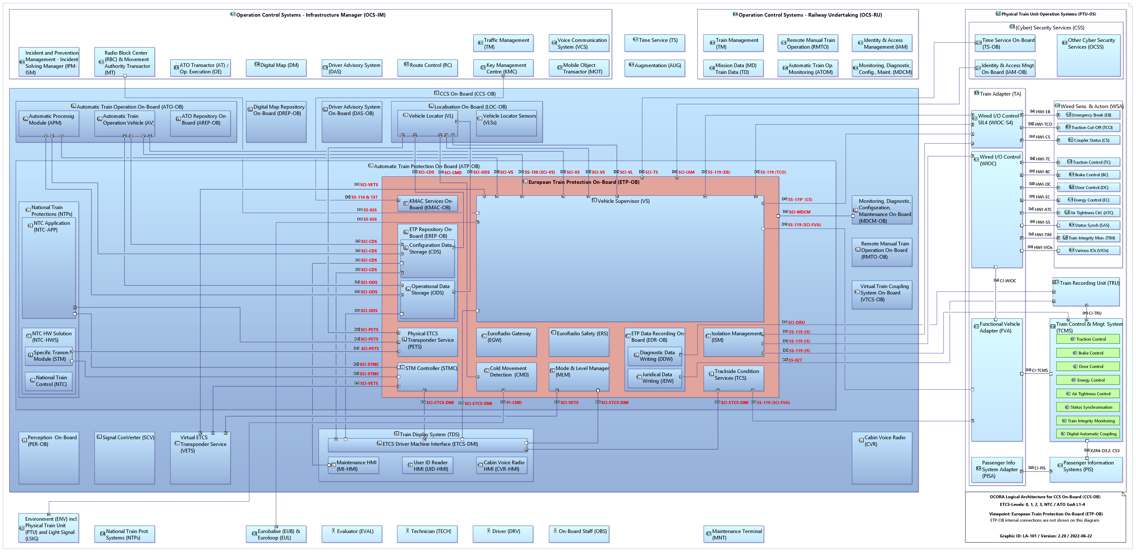
Logical Architecture ETP-OB Actors, External Interfaces, Components
European Train Protection On-Board (ETP-OB)
1)
1) May be moved into the PTU-OS / LOC&PAS domain.
May be moved into the PTU-OS / LOC&PAS domain.
SS-nnn Respective subset contains information for the interface
SS-nnn* Respective subset does not address the interface but should contain the information in the future.

Slide 18
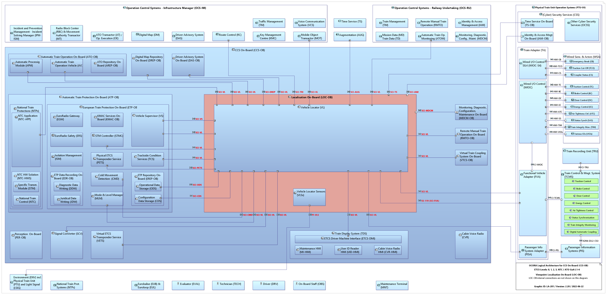
Logical Architecture LOC-OB Actors, External Interfaces, Components
Localisation On-Board (LOC-OB)
1)
1) May be moved into the PTU-OS / LOC&PAS domain.
May be moved into the PTU-OS / LOC&PAS domain.
SS-nnn Respective subset contains information for the interface
SS-nnn* Respective subset does not address the interface but should contain the information in the future.

Slide 19
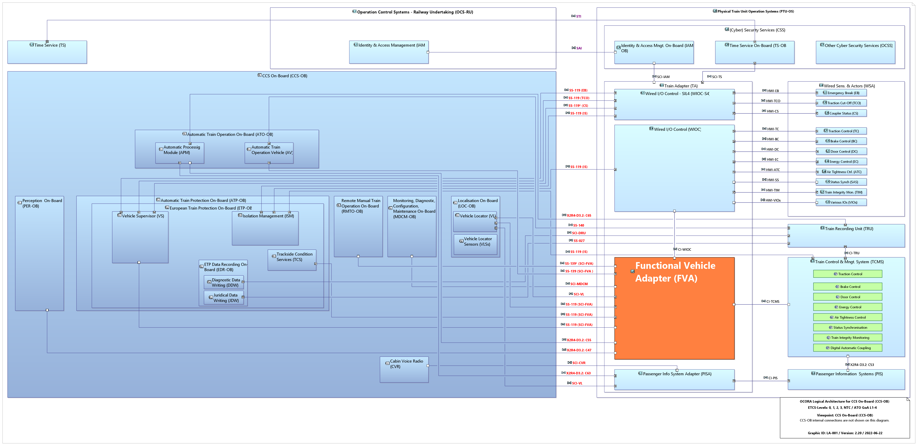
Logical Architecture FVA Actors and External Interfaces
1) May be moved into the PTU-OS / LOC&PAS domain.
May be moved into the PTU-OS / LOC&PAS domain.
SS-nnn Respective subset contains information for the interface
SS-nnn* Respective subset does not address the interface but should contain the information in the future.

Slide 20
CCS On-Board (CCS-OB) Physical Architecture

Slide 21
Physical Architecture CCS-OB – Legacy Train Actors, Interfaces, Hardware Components
CCS On-Board (CCS-OB)
CCN (SS-147)
HW-SIL4
CCN
(SS-147)
CCN
(SS-147)
CCN
(SS-147)
CCN
(SS-147)
CCN
(SS-147)
CCN
(SS-147)
CCN
(SS-147)
CCN
(SS-147)
CCN
(SS-147)
CCN
(SS-147)
CCN
(SS-147)
CCN
(SS-147)
CCN
(SS-147)
CCN
(SS-147)
CCN
(SS-147)
CCN
(SS-147)
CCN (SS-147)
CCN (SS-147)
SS-035
SS-057
CCN (SS-147)
UIC
CI-NTP
HMI-UIDR
HMI-CVD
HMI-TDS
PI-PER-OB
PI-VLS
PI-CMD
SS-036
SS-044
SS-037
HMI-CVR
GSM-R Voice

Slide 22
Physical Architecture CCS-OB – NG Train Actors, Interfaces, Hardware Components
CCS On-Board (CCS-OB)
HW-SIL4
CCN
(SS-147)
CCN
(SS-147)
CCN
(SS-147)
CCN
(SS-147)
CCN
(SS-147)
CCN
(SS-147)
CCN (SS-147)
SS-035
SS-057
CI-NTP
HMI-UIDR
HMI-CVD
HMI-TDS
PI-PER-OB
PI-VLS
PI-CMD
SS-036
SS-044

Slide 23
Building Blocks

Slide 24
Building Blocks
Definition
A building block is a sourceable unit of the CCS on-board system (hardware and/or software), having standardised functionality, standardised performance (RAM), standardised safety (including Tolerable Functional Failure Rate [TFFR], Safety Integrity Level [SIL] and Safety Related Application Conditions [SRAC]), standardised security and standardised interfaces towards other building blocks and/or external systems.
Combined HW/SW Building blocks exclusively communicating with each other through the CCS Communication Network (CCN) through standardise interfaces.
SW Building blocks, deployed on an instance of the generic Safe Computing Platform, shall communicate with each other through the standardised platform independent Application Programming Interface (API). Communication with computing platform external systems will be realised by the computing platform (integrating with the CCN).
Building blocks are modifiable / adaptable and therefore portable / replaceable, without impacting other building blocks.

Slide 25
Scenario 1
Building Blocks without Safe Computing Platform (dedicated hardware for each functional cluster)
Legacy Train Example
CCS Off-Board Support (COBS)
CCS On-Board (CCS-OB)
Other
Application
(Signal Conv., Virtual ETCS Transponder Service, etc.)
Virtual Train Coupling System On-Board
(VTCS-OB)
Remote Manual Train Operation
On-Board
(RMTO-OB)
Digital Map Repository
On-Board
(DREP-OB)
Automatic Train Operation
On-Board
(ATO-OB)
Driver Advisory System
On-Board
(DAS-OB)
Monitoring, Diagnostic, Configuration, Maintenance
On-Board
(MDCM-OB)
Train Adapter (TA)
CCS Communication Network (CCN)
Perception
On-Board
(PER-OB)
Localisation
On-Board
(LOC-OB)
European Train Protection On-Board
(ETP-OB)
(Cyber)-Security (CSEC)
(Cyber)-Security Services (CSS)
Security Network
ECN / ECN
Security
Gateway
National Train Protections
(NTPs)
User Identification
& Authentication (UIA)
Cabin Voice Radio VoIP (CVR-V)
Train Display
System (TDS) ¹⁾
Cabin Voice Radio
Legacy (CVR-L)
COM Network
FRMCS
On-Board
System
MCG (CCS)
On-Board
System
Connectivity Services
Current CCS-OB Functionality
Future CCS-OB Functionality

Slide 26
Scenario 2
Building Blocks with Safe Computing Platform for some Applications
Legacy Train Example
CCS Off-Board Support (COBS)
CCS On-Board (CCS-OB)
Other
Application
(Signal Conv., Virtual ETCS Transponder Service, etc.)
Virtual Train Coupling System On-Board
(VTCS-OB)
Remote Manual Train Operation
On-Board
(RMTO-OB)
Digital Map Repository
On-Board
(DREP-OB)
Automatic Train Operation
On-Board
(ATO-OB)
Driver Advisory System
On-Board
(DAS-OB)
Monitoring, Diagnostic, Configuration, Maintenance
On-Board
(MDCM-OB)
Functional Vehicle
Adapter
(FVA)
Train Adapter (TA)
Safe Computing Platform (SCP)
API
API
API
API
API
API
API
API
CCS Communication Network (CCN)
Perception
On-Board
(PER-OB)
Localisation
On-Board
(LOC-OB)
European Train Protection On-Board
(ETP-OB)
(Cyber)-Security (CSEC)
SIL4 I/O
Ports
(Cyber)-Security Services (CSS)
Security Network
ECN / ECN
Security
Gateway
National Train Protections
(NTPs)
User Identification
& Authentication (UIA)
Cabin Voice Radio VoIP (CVR-V)
Train Display
System (TDS) ¹⁾
Cabin Voice Radio
Legacy (CVR-L)
COM Network
FRMCS
On-Board
System
MCG (CCS)
On-Board
System
Connectivity Services
Current CCS-OB Functionality
Future CCS-OB Functionality

Slide 27
Scenario 3
Building Blocks with Safe Computing Platform for all Applications
Legacy Train Example
CCS Off-Board Support (COBS)
CCS On-Board (CCS-OB)
Other
Application
(Signal Conv., Virtual ETCS Transponder Service, etc.)
Virtual Train Coupling System On-Board
(VTCS-OB)
Remote Manual Train Operation
On-Board
(RMTO-OB)
Digital Map Repository
On-Board
(DREP-OB)
Automatic Train Operation
On-Board
(ATO-OB)
Driver Advisory System
On-Board
(DAS-OB)
Monitoring, Diagnostic, Configuration, Maintenance
On-Board
(MDCM-OB)
Functional Vehicle
Adapter
(FVA)
Train Adapter (TA)
Safe Computing Platform (SCP)
API
API
API
API
API
API
API
API
CCS Communication Network (CCN)
Safe Computing Platform (SCP)
(Cyber)-Security (CSEC)
API
API
API
SIL4 I/O
Ports
(Cyber)-Security Services (CSS)
Security Network
ECN / ECN
Security
Gateway
National Train Protections
(NTPs)
User Identification
& Authentication (UIA)
Cabin Voice Radio VoIP (CVR-V)
Train Display
System (TDS) ¹⁾
Perception
On-Board
(PER-OB)
Localisation
On-Board
(LOC-OB)
European Train Protection On-Board
(ETP-OB)
Cabin Voice Radio
Legacy (CVR-L)
COM Network
FRMCS
On-Board
System
MCG (CCS)
On-Board
System
Connectivity Services
Current CCS-OB Functionality
Future CCS-OB Functionality

Slide 28
Scenario 4
Building Blocks with Safe Computing Platform for all Applications
New Generation Train Example
CCS Off-Board Support (COBS)
CCS On-Board (CCS-OB)
Other
Application
(Signal Conv., Virtual ETCS Transponder Service, etc.)
Virtual Train Coupling System On-Board
(VTCS-OB)
Remote Manual Train Operation
On-Board
(RMTO-OB)
Digital Map Repository
On-Board
(DREP-OB)
Automatic Train Operation
On-Board
(ATO-OB)
Driver Advisory System
On-Board
(DAS-OB)
Monitoring, Diagnostic, Configuration, Maintenance
On-Board
(MDCM-OB)
Safe Computing Platform (SCP)
API
API
API
API
API
API
API
CCS Communication Network (CCN)
Safe Computing Platform (SCP)
(Cyber)-Security (CSEC)
API
API
API
SIL4 I/O
Ports
Identity and Access Management
(IAM-OB)
Time Service (TS-OB)
Security Network
ECN / ECN
Security
Gateway
National Train Protections
(NTPs)
User Identification
& Authentication (UIA)
Cabin Voice Radio VoIP (CVR-V)
Train Display
System (TDS) ¹⁾
Perception
On-Board
(PER-OB)
Localisation
On-Board
(LOC-OB)
European Train Protection On-Board
(ETP-OB)
COM Network
FRMCS
On-Board
System
MCG (CCS)
On-Board
System
Connectivity Services
Current CCS-OB Functionality
Future CCS-OB Functionality

Slide 29
Train Integration Scenarios

Slide 30
NG-TCN Train – Scenario A
(CCN as physically separated network from Sec Net, Op Net, NG TCN
and Com Net with support for legacy trackside infrastructure)

Slide 31
NG-TCN Train – Scenario B
(CCN as logically separated network from NG TCN and physically separated
from Sec Net, Op Net and Com Net with support for legacy trackside infrastructure)

Slide 32
NG-TCN Train – Scenario C
(Common CCN and TCMS network logically separated from A-TCMS and physically
separated from Sec Net, Op Net and Com Net with support for legacy trackside infrastructure)

Slide 33
NG-TCN Train – Scenario D
(Common CCN and TCMS network physically separated from A-TCMS, Sec Net,
Op Net and Com Net with support for legacy trackside infrastructure)

Slide 34
Legacy Train
(CCN physically separated from Sec Net and Com Net using the OCORA GW connecting to the TCMS / PIS Networks. Support for legacy trackside infrastructure)

Slide 35
Network Topology Scenarios

Slide 36
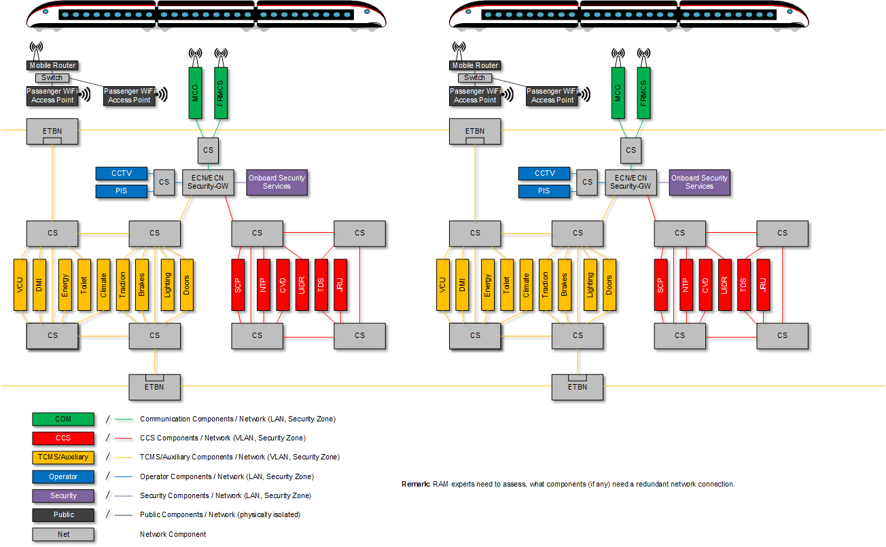
Scenario A: CCN as physically separated network

Slide 37
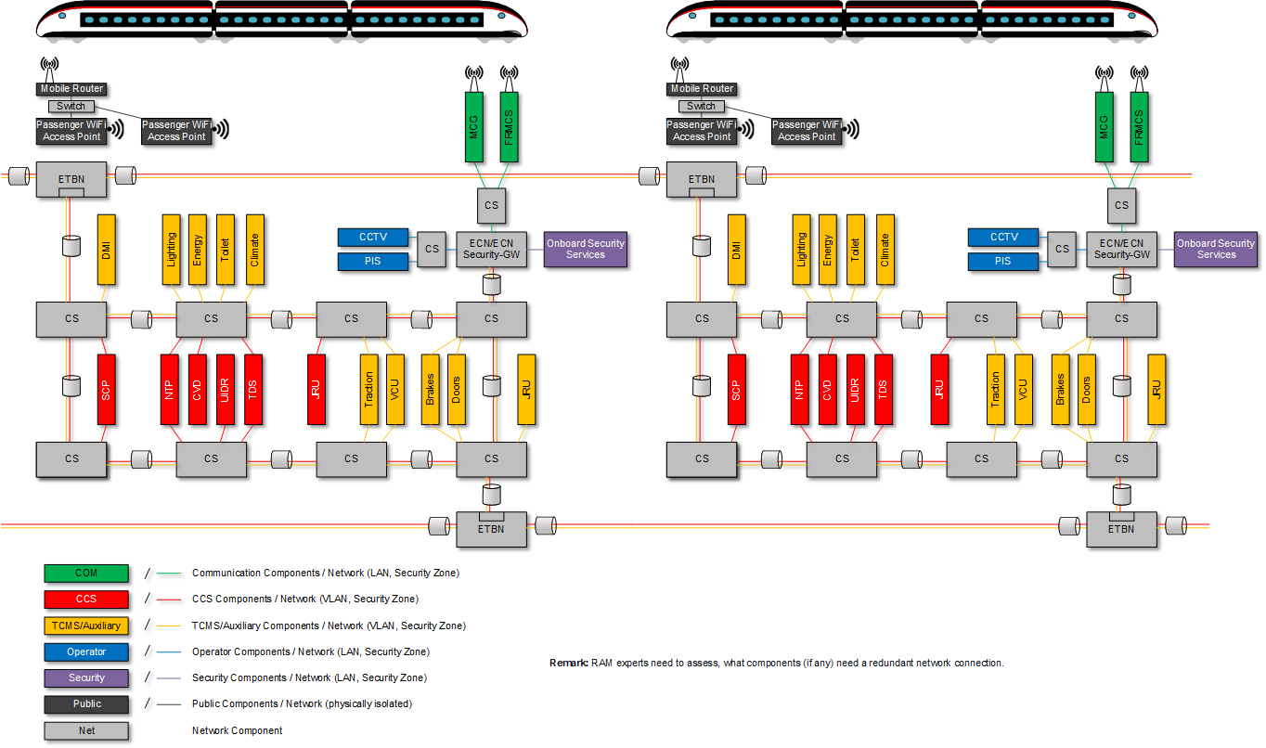
Scenario B: CCN as logically separated network

Slide 38
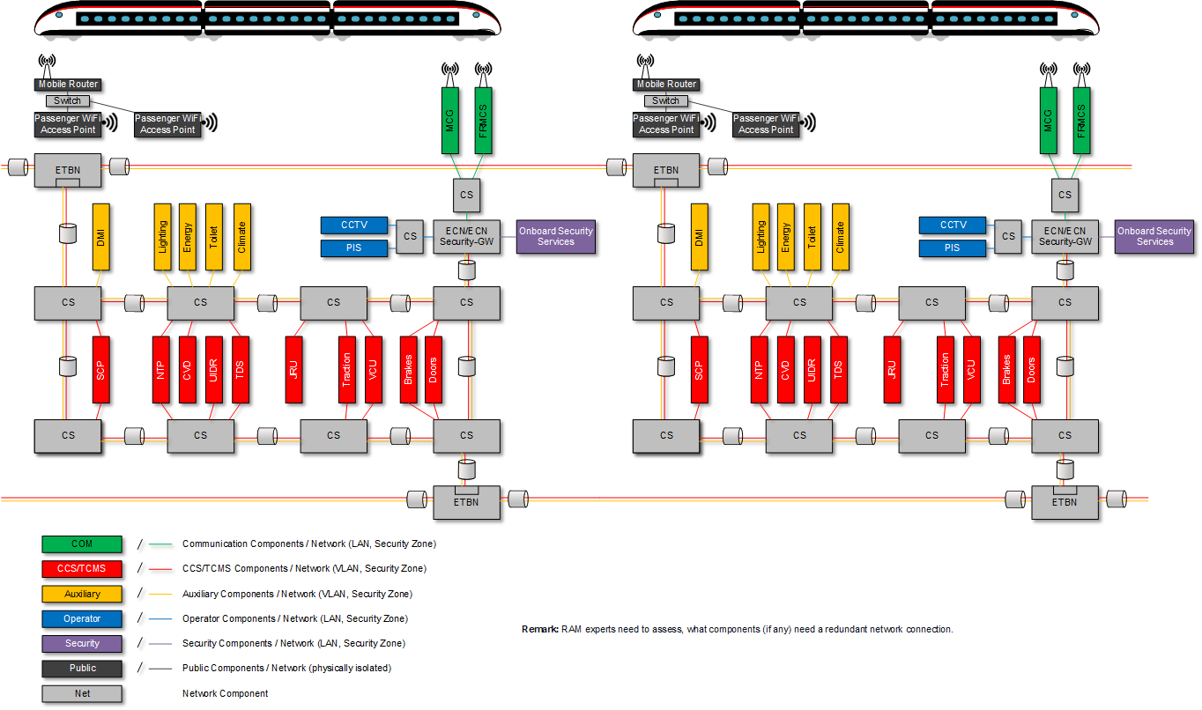
Scenario C: Common critical control network logically separated

Slide 39
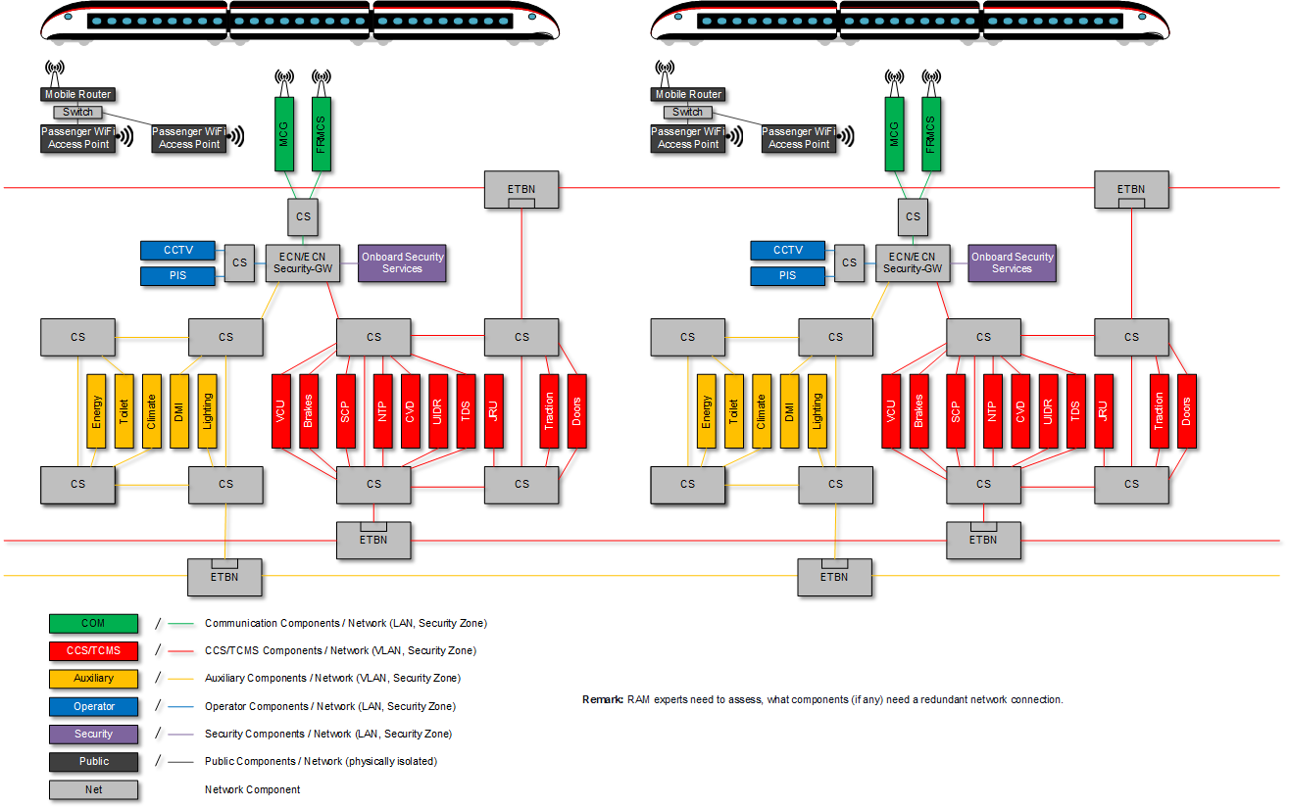
Scenario D: Common critical control network physically separated

Slide 40
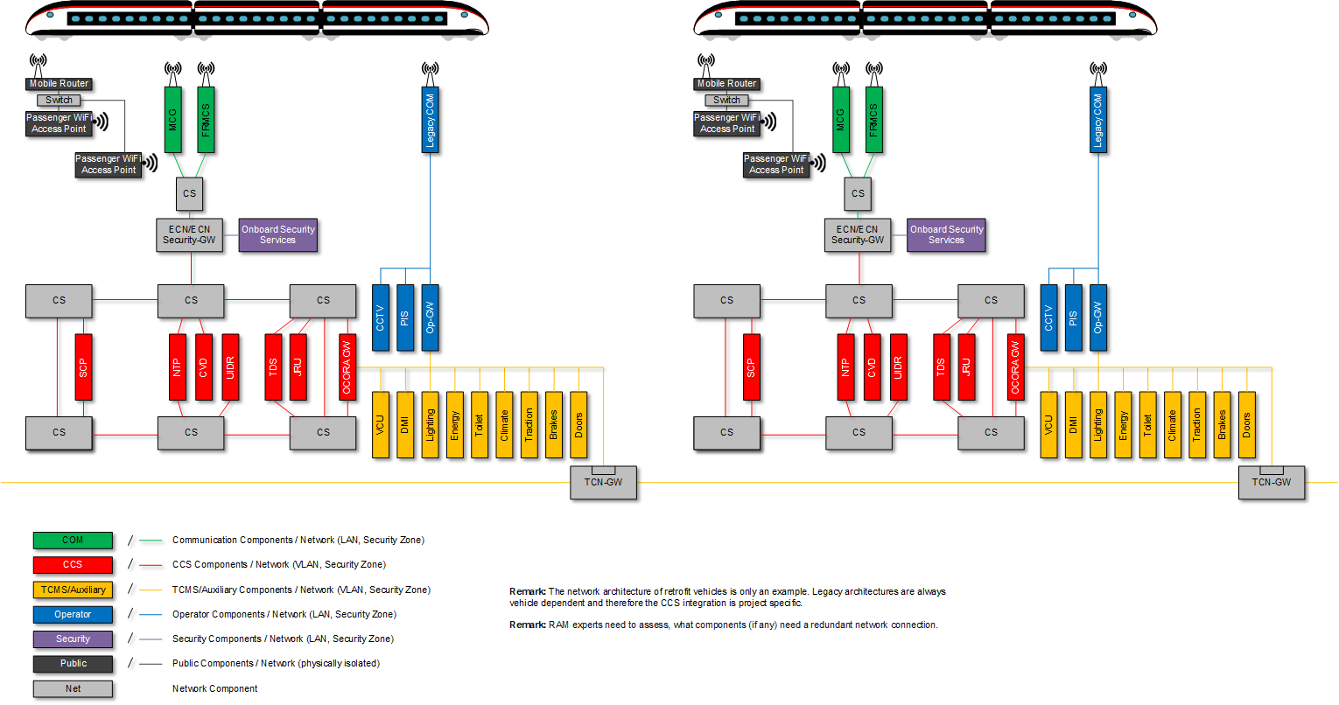
Legacy Train – Integration with OCORA-GW

Slide 41
Computing Platform

Slide 42
Computing Platform – High Level Architecture
Functional Application (Business Logic)
uses
Platform Independent API
implements
System Services
Runtime environment
Safety Services
Comm Stack
IT Security
Operating System (if needed)
Virtualisation (if needed)
Computing Platform
Hardware Independence *
Board Support Package
* It is to be discussed to which extent hardware independence can or should be enforced
Hardware
Computing Node(s)

Slide 43
Computing Platform – Deployment Options
Option A:
Hardware without operating system
Option B:
Hardware with operating system
Option C:
Separation kernel / hypervisor based system
Functional App. Replica
Functional App. Replica
Func. App. 1 Replica
Func. App. 2 Replica
Safety & System Services
Partition
Partition
Partition
Partition
Partition
Functional App. Replica
Functional App. Replica
Partition
Partition
Func. App. 1 Replica
Func. App. 2 Replica
Safety & System Services
Functional App. Replica
Partition
Partition
Partition
Functional App. Replica
Partition
Func. App. 1 Replica
Func. App. 2 Replica
Safety & System Services
Partition
PI API
Partition
Partition
Partition
Likely options for onboard deployments
PI API
PI API
PI API
PI API
PI API
Safety & System Services
Safety & System Services
PI API
PI API
PI API
PI API
Safety & System Services
Separation Kernel / Hypervisor
Safety & System Services
Safety & System Services
PI API
PI API
Safety & System Services
Operating System
Separation Kernel / Hypervisor
Board Support Package
Operating System
Board Support Package
Board Support Package
Operating System
Separation Kernel / Hypervisor
Multi-Core Node
Board Support Package
Board Support Package
Board Support Package
Board Support Package
Multi-Core Node
Multi-Core Node
Multi-Core Node
Board Support Package
Board Support Package
Multi-Core Node
Multi-Core Node
Multi-Core Node
Multi-Core Node
Multi-Core Node
Option D:
Orchestrated virtualisation
environment
Func. App. 2 Replica
Partition
Func. App. 2 Replica
Partition
Func. App. 2 Replica
Func. Appl. 1 Replica
VM / Partition
Partition
PI API
Func. Appl. 1 Replica
Partition
PI API
Func. App. 1 Replica
VM / Partition
Safety & System Services
PI API
PI API
Likely option for trackside deployments
PI API
Safety & System Services
Safety & System Services
Safety & System Services
PI API
Operating System
Safety & System Services
Operating System
Safety & System Services
Operating System
Orchestration
Separation Kernel / Hypervisor
Platform options where applications are programmed against PI API
Approaches depicted in the diagram are non-exhaustive. The industry may propose different state-of-the-art solutions.
Separation Kernel / Hypervisor
Board Support Package
Virtualisation
Board Support Package
Multi-Core Node
Board Support Package
Multi-Core Node
Multi-Core Node

Slide 44
Functional Vehicle Adapter (FVA)

Slide 45
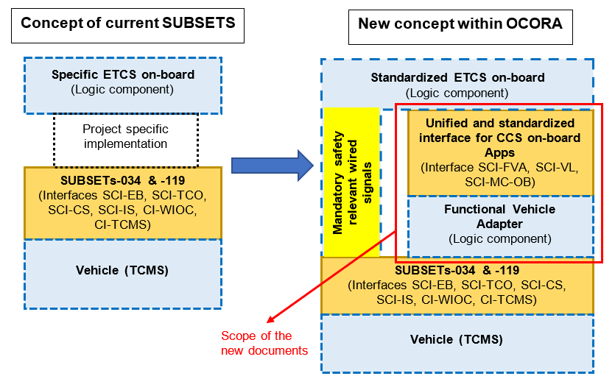
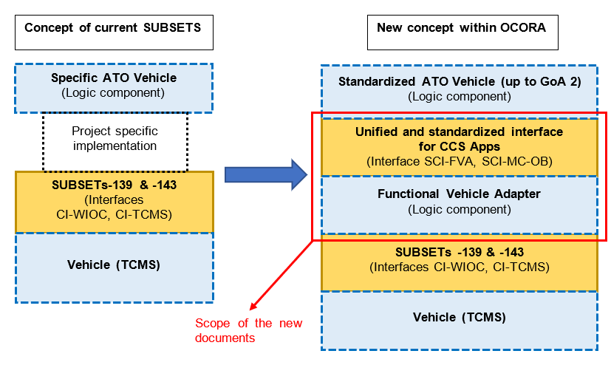
OCORA – Functional Vehicle Adapter
ETCS
ATO
Details in Document: OCORA-TWS04-010 – Functional Vehicle Adapter - Introduction

Slide 46
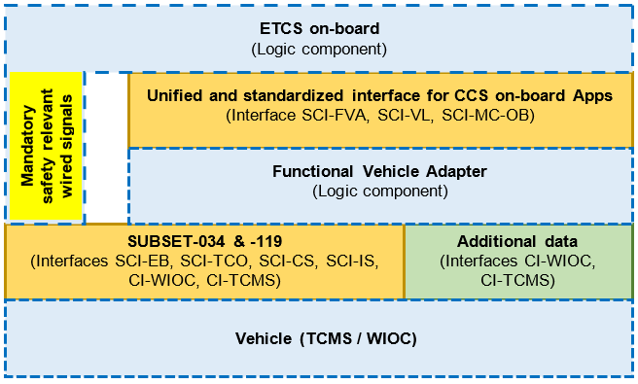
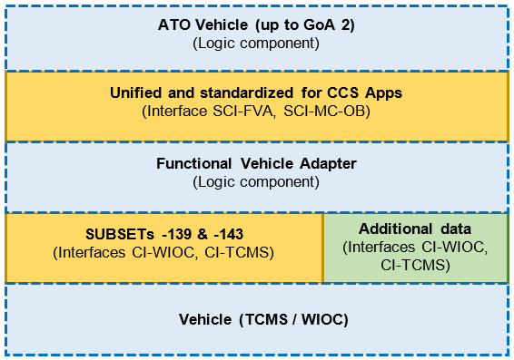
OCORA – Functional Vehicle Adapter: Extensions
ETCS
ATO
Details in Documents: OCORA-TWS04-013 – Design Guideline

Slide 47
Modular Safety

Slide 48
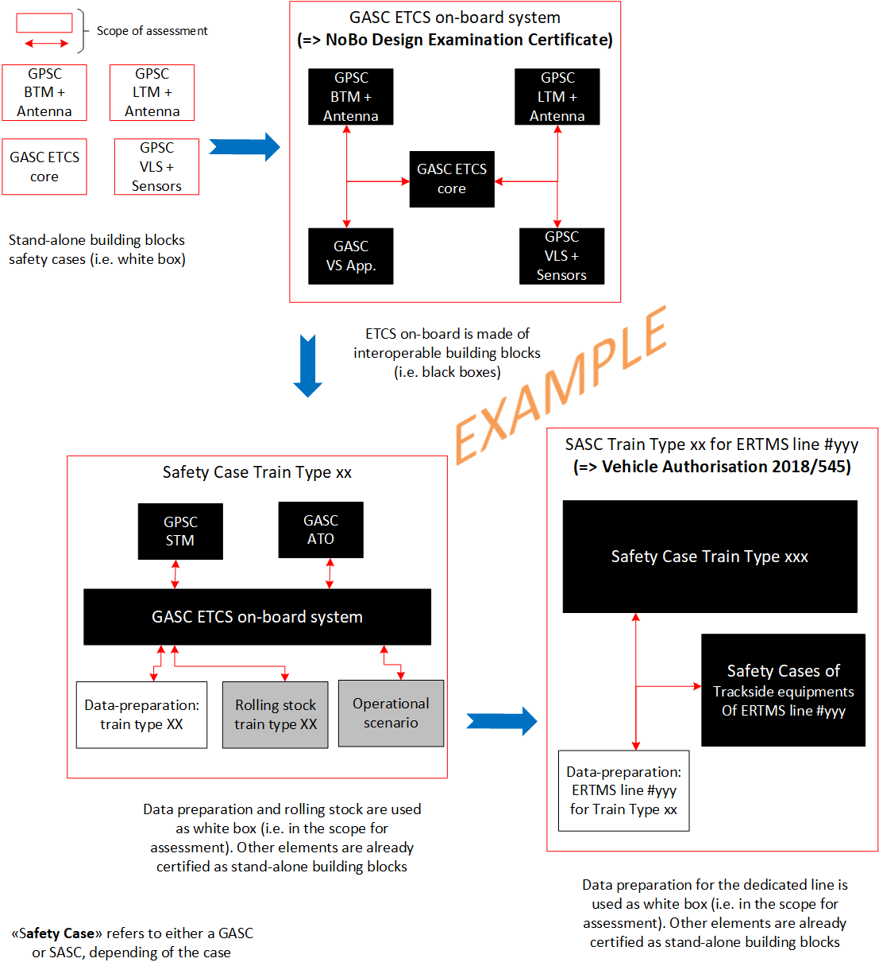
OCORA – Modular Safety
Modular Safety defines the hierarchy between safety cases from building blocks to specific application(s).
One of the main goal is to reduce the certification efforts (initial- and re-certification) at all levels without degrading the safety level of the analyses.
Modular Safety shall also defines the safety elements to allow the homologation of stand-alone building blocks:
Hazardous events based on TSI CCS SUBSET-088
TFFR (Tolerable Functional Failure Rate) based on TSI CCS SUBSET-088
Safety requirements based on OCORA Delta release
Harmonised and generic set of SRAC

Slide 49
OCORA – Modular Safety - Stakeholders
➔ Contracting entities (Oprators)
The integrator of the CCS/ETCS on-board system shall coordinate the activities of the different suppliers to integrate their sub-systems and ensure that finally, ISA and NoBo certificates of the CCS/ETCS on-board system will be delivered by the assessor
➔ Integrator(s)
➔ Manufacturers (Building Blocks, Application…)
➔ Other (ISA/ NoBo, DeBo..)

Slide 50
OCORA – Modularity & Safety Approval
Each color represents a different supplier
Each building block is delivered to the ETCS on-board integrator with its own ISA/NoBo certificates
ETCS on-board integrator realise their "safe integration" as defined in era_1209-063 Clarification Note On Safe Integration (I.e. black boxes)
Based on ETCS on-board ISA/NoBo certificates, CCS on-board integrator realise the safe integration of the STM (I.e. black boxes)
CCS and ETCS on-board systems are used by the vehicle integrator to get the train type ISA/NoBo certificates (I.e. integration is eased thanks to the FVA)
The contracting entity can apply for the different vehicle authorisations required
A generic and systematic approach defined by OCORA, based on CSM-RA will then help any above stakeholder to handle easier (I.e. less delay and costs than today) the evolutions at any level
Case of two independent systems made of building blocks from different suppliers

Slide 51
OCORA – Modularity & Integration Tasks
Unified Operation concept
System Operated and maintained
Trace
5
System Integration and Validation
➔ Integrator (System)
System level
Design refinement
4
Vehicle level Integration & Testing
Other Subsystems
On-board CCS Subsystem
Moduar integration from « Blocks » to « complete CCS »
➔ Integrator (onboard)
3
Onboard CCS subsystem level Integration & Testing
Design refinement
Build. Block design
2
Building Blocks Testing
SW validation
SW validation
CCS Trackside
Other Subsystems
➔ Manufacturers (Building Blocks, Application…)
In OCORA compliant projects, the integrator is identified as the key player for Safety, Integration and Testing of the on-board CCS system.
SW implement.
Scope of OCORA
1
Appl. SW Testing
1, 2..: integration steps

Slide 52
OCORA – Modularity & Integration Tasks
Modular CCS Stakeholders
➔ Contracting entities (RU §IM)
➔ Integrator(s)
In OCORA compliant projects, the integrator is identified as the key player for Safety, Integration and Testing of the on-board CCS system
➔ Manufacturers (Building Blocks, Application…)
➔ Other (ISA/ NoBo, DeBo..)

Slide 53
Methodology & Tooling

Slide 54
OCORA Requirements Engineering
Structuring the Requirements
Vision & Objective of future CCS (ERA, RUs, IMs)
OCORA Vision & Objectives of future CCS On-Board
RCA
Standards, Regulations & Specifications
Usage Scenarios
Other European Initiatives
TOBA
SFERA
EEIG EUG
Shift2Rail¹⁾
A
A
A
OCORA Initiative (OCI)
CCS On-Board (COB)
Program- & Design Requirements
(Design-, Tool-, Process-, Methodology-, Collaboration-, Planning-Requirements, etc.)
System Analysis
B
C
B
System Architecture
A
Functional
Requirements
Non-Functional
Requirements
Interface
Specifications
Functional
Requirements
Non-Functional
Requirements
Interface
Specifications
Functional
Requirements
Non-Functional
Requirements
Interface
Specifications
A
B
D
D
D
D
D
D
D
D
D
Design/Implementation
1) CONNECTA, LINX4RAIL, X2RAIL-4, TAURO
Building Block 1
Building Block 2
Building Block n

Slide 55
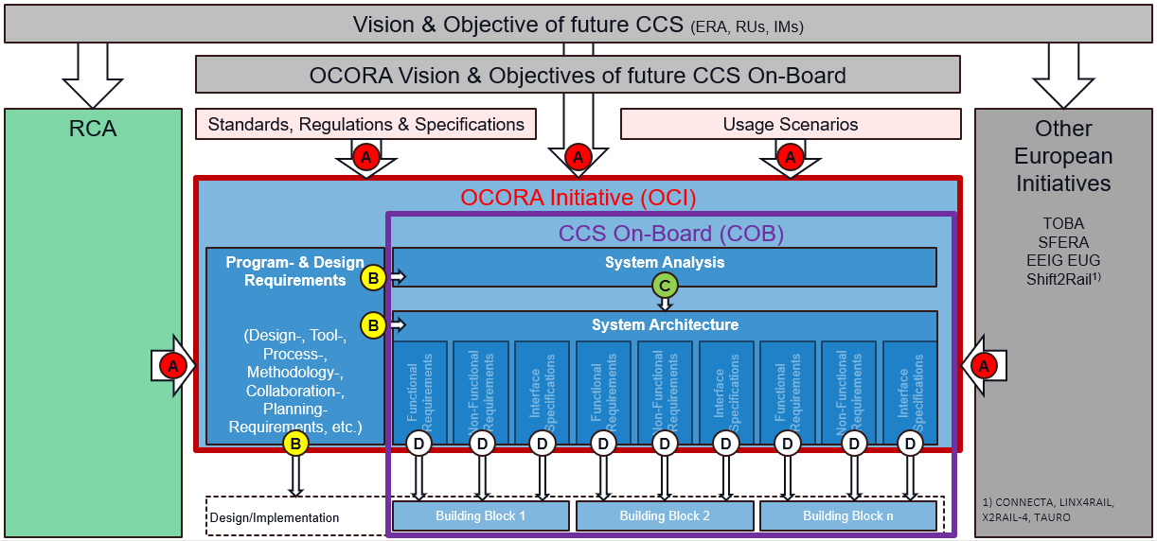
OCORA Requirements Engineering
Requirement Definitions
Stakeholder Requirements: OCORA has to manage many different requirements, coming from many different stakeholders.
Program- & Design Requirements: The OCORA program defines tools, processes, methodologies and design rules to be used within the program and to be considered during the system analysis and the system design/architecture work.
System Requirements: Requirements in regards to the OCORA system are developed in the MBSE System Analysis (RCA & OCORA), taking into account the A- and B-Level Requirements.
Building Block Requirements: Requirements in regards to the OCORA building blocks are developed in the MBSE System Architecture (logical / physical), taking into account the MBSE System Analysis. The resulting documentation form the OCORA tender templates, together with the applicable program requirements.
A
B
C
D

Slide 56

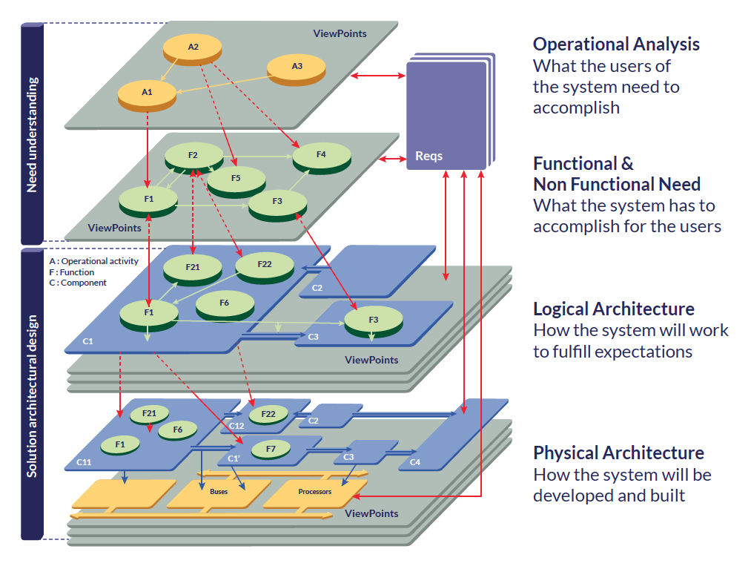




Interaction between CENELEC Process and MBSE
Includes selected A-Level Req.
A
CENELEC PROCESS
Polarion
MBSE
Capella
Concept
Linx4Rail Scope
System Need
Operational Analysis
System Definition
C
RCA Scope
CCS End-2-End
System Analysis
Risk Analysis
System Need
System Analysis
CENELEC phases CP1-6 as per EN 50126
Iteration
Technical Requirements (partial)
RAMSS
OCORA Scope
CCS On-board
Program Requirements
System Requirements
B
Architecture & Apportionment
System Design
Logical Architecture
Physical Architecture
D
B
D
6
Design & Implementation
C
MBSE artefacts to be used in the CENELEC P2 (System Definition) documentation.
D
MBSE artefacts to be used in the CP5 (Architecture & Apportionment) documentation and for tenders.

Slide 57

OCORA in Context of the relevant CENELEC Projects
OCORA
CENELEC
Process
Train XX on Track YY (SA)
Integrator (e.g. RU)
OCORA Artefacts
Train Type XX (GA)
Integrator (e.g. RU)
CCS On-Board (GA)
Integrator (e.g. RU)
CENELEC P1
OCORA Building Block n
OCORA Building Block 2
CENELEC P2
OCORA Building Block 1 e.g. Vehicle Supervisor
CENELEC P3
CENELEC P4
CENELEC P5
OCORA Tasks
Integr. Tasks 1
Industry Tasks
Integr. Tasks 2
Integr. Tasks 3
Chronological

Slide 58
OCORA CENELEC Process

Slide 59
Operational Concept

Slide 60

Operational Concept Overview
Live Cycle of Passenger, Freight, and Construction Trains
+/- 40 years overall life-time
Upgrades and updates
Refurbishment / modernisation
Entry in service
Operate and maintain
Disposal / out of service
Yearly
Cycle
Yearly
Cycle
Yearly
Cycle
Yearly
Cycle
Construction Train (Yellow Fleet)
Passenger Train
Freight Train
Yearly
Cycle
Yearly
Cycle
Seasonal weather effects
Seasonal weather effects
Seasonal weather effects
Starting up train
Starting up engine
Starting up engine
Type of passengers
Maintenance
Type of payload
Maintenance
Type of payload
Maintenance
Drive train to 1st Platform
Drive engine to wagons
Drive engine to construction site
Standard Daily Cycle
Driving
Standard Daily Cycle
Driving
Standard Daily Cycle
Driving within construction site
Halting / Boarding / Alighting*
Halting / Coupling / De-Coupling
Halting / Perform Task
Cleaning
Special operation
Cleaning
Special operation
Cleaning
Special operation
Drive train to parking field
Drive engine to parking field
Drive engine to parking field
Shutting down train
Shutting down train
Shutting down train
Yearly
Cycle
Yearly
Cycle
Yearly
Cycle
Yearly
Cycle
Yearly
Cycle
Yearly
Cycle
*includes also Coupling / De-coupling

